Slide 1

Key Considerations for Designing and Redefining the IIPS Target Operating Model
Inclusive Financial Systems
Dr. Oluwaseun (Olu) Owoeye
October 2025

Slide 2
The Midnight Call to Serve: A Real-Life Scenario
People Disconnection
Technology Performance Monitoring Failure
Process Failure
Service Failure
Leading to Ecosystem Catastrophe

Slide 3

Target Operating Model (TOM)
Serves as the linkage between various elements of the current state (i.e. processes, technology, governance, and people) and improvement plans to deliver value for the future state.
Serves as a foundational framework to execute organizational vision and mission, to meet current and future business objectives.

Slide 4

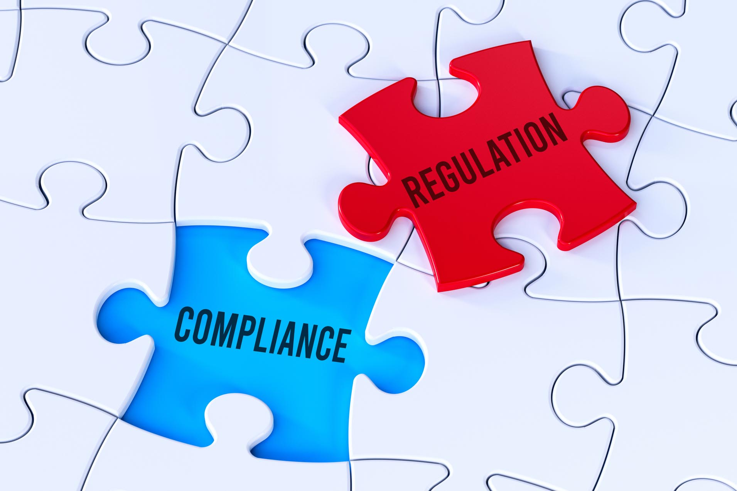


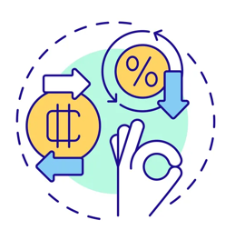

IIPS Target Operating Model Design Considerations
Instant Payments contributes over 75% of global retail payments and it is projected to hit a 90% threshold by 2030
Focus on Interoperability & a more Connected 24/7 Digital Economy
Increasing Regulatory
Compliance Requirements
Payment Platform Modernization – Balancing Resiliency, Security, Reliability, Affordability & Safety
Platform Re-factoring for Combinational Innovation and Co-opetition
Sustainable Economic Model & The Race Against Cash
Fast-Paced Demands for Identity Payments & Real-Time Services

Slide 5

Inclusive Instant Payment System Target Operating Model
Inclusive Instant Payment System Target Operating Model Framework
IIPS Ecosystem Aspiration
Vision
Mission
Strategy
Technology
Resilient, Secured & Scalable Infrastructure
Balanced Technology Acquisition & ROI
Business Intelligence & Digital Transformation
Shared Platform Services - 24/7 Availability
Secured Integration & Message Exchange
Process
Performance Evaluation & Monitoring
Escalation Management
Participant Onboarding
Operational Reliability
Payments Modernization
Process Re-engineering & Automation
IIPS Ecosystem Expectations
Optimal Performance
Low-Cost Payment Products & Services
Enhanced UX
Shared Prosperity
Trust
Security
Interoperability
Real-Time Economy
People
Commitment to Vision and Mission
Defined Roles and Responsibilities
Highly Skilled Workforce
Ecosystem Collaboration
Customer Centric Value Proposition
Governance
Scheme Rules
Standard Operating Guidelines
Board & Management Structure
Compliance & Risk Management
Service Level Agreements
Implementation Principles
Build a comprehensive ecosystem commitment to transition to the future state
Ensure design architecture reflects sustainability and long-term success
Building Instant Payment of Value
for Financial Inclusion

Slide 6
Achieving the Target State and Future Success Through TOM: Three Critical ‘’How’’ Questions to Mature TOM Governance and Administration

Slide 7
Maturing TOM Governance and Administration
Evaluate
Refine
Sustain
Implement a performance and service quality improvement strategy
Promote co-opetition sustainable economic model and a continuous improvement culture
Invest in people, process re-engineering, technology innovations and digital transformation with long term success lens

Slide 8
Closing Thoughts
‘’IIPS is a mission critical Infrastructure, it underpins effective functioning of national economy and long-term success of its Target Operating Model is a collective effort of all ecosystem participants’’
Real-Time Payments
Brings
Real-Time Problems
and Requires
Real-Time Solutions

Slide 9
Thank You.

